Slide 1

Modern Development Deep Dive:
Building a Modern Web Application
Allen Conway
Lead Consultant
Magenic
Level: Intermediate

Slide 2

Intro
Allen Conway
Blog: http://www.AllenConway.net
Twitter: @AllenConway, http://www.twitter.com/AllenConway
GitHub: https://github.com/AllenConway
Email: AllenC@Magenic.com

Slide 3

What we will cover
MyVote Application
Modern Web Applications From the Ground Up
VS.NET SPA Templates
Azure Websites
Azure Mobile Services / Security
A look at JavaScript
Building an AngularJS app with TypeScript
Responsive Web Design
Real-Time Messaging with SignalR

Slide 4

The MyVote JS App Technology Stack
HTML5/CSS3 Responsive Design
AngularJS + TypeScript
Azure Web Sites and Azure Mobile Services
ASP.NET Web Pages (not MVC!)
ASP.NET Web API
CSLA
Azure SQL Server

Slide 5

The State of the Modern Web
JavaScript Frameworks are maturing
OSS Community provides choices at a feverish pace
Knowledge of building for the modern web is becoming more mainstream
The server is leveraged differently
Desktop browser isn’t the main player
bit.ly/1Q9pEiy

Slide 6
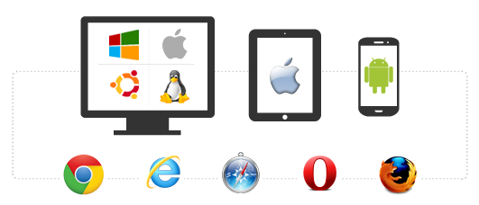
Cross Browser, Platform, Device
JavaScript Applications + Responsive design
Browser and device agnostic
Best on browsers supporting HTML5 and CSS3
http://caniuse.com/
More accepted on mobile devices
JavaScript will rule the world!!
Should I go to the web?
Native per platform
Xamarin
Hybrid/PhoneGap
http://magenic.com/Resources/ID/2

Slide 7

How are JavaScript Applications different from ASP.NET MVC or Webforms?
Shift in application logic from the server to the client
UI and application logic is now done in the browser
How HTML is delivered
ASP.NET web apps merge data with HTML before delivering to the client
Server’s main responsibility: Data
JavaScript MV* Frameworks

Slide 8



JS Applications at a Glance
Advantages
Lean & Performant
Responsive
Device Reach
Familiar Patterns
Narrowing the gap from UX perspective: desktop ⬄ web
Challenges
JavaScript is Required
Learning Curve
Overwhelming choices
Mindset shift
Volatility of frameworks/libraries

Slide 9
Building a modern web app from the ground up
VS.NET 2013/5 technically have a SPA template
Biggest Swiss army knife you’ve ever seen
Begin with an empty ASP.NET application
Pull in only what is needed
Start with JS Framework, Bootstrap, Modernizr, Typescript definitions
If unsure of where to start, work backwards cleaning house in SPA template
Strip out what isn’t needed
https://github.com/AllenConway/JSAppBasicTemplate

Slide 10
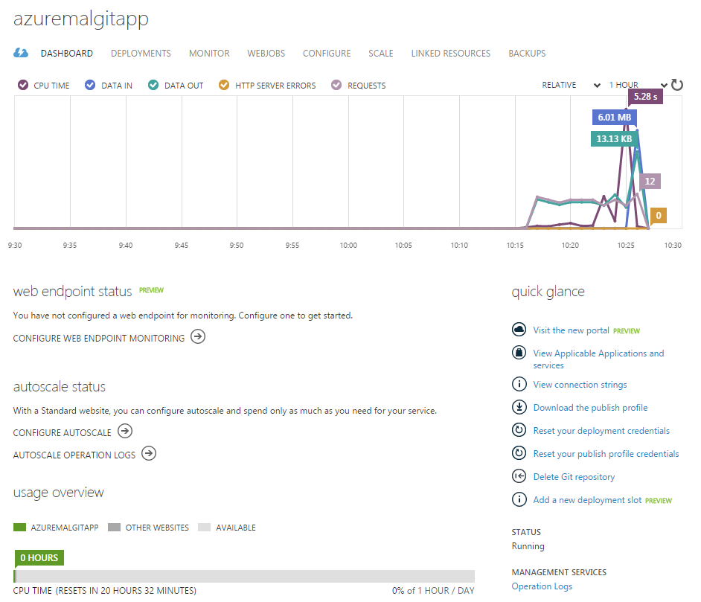

Azure Websites
Host your own web applications
Multiple hosting options
Multiple Source Control Integration Options
Azure Management Portal
Easy to use – no IIS or server to manage

Slide 11

Azure Mobile Services
Platform parity
Facilitate a shared experience
Identity
Data/Sync
Notifications
Backend jobs
Push Notification support
Fastest way to get up and running

Slide 12
Secure Token Service
Login Info
STS Provider
Token
Facebook
Custom Application

Slide 13
Azure Mobile Services Security
Authentication
Leverage multiple mainstream identity providers
Authorization
Hand roll in app
Table permissions on Azure
Use scripts in Azure
Leverage HTML5 Local Storage
Store JWT from AMS
https://github.com/Magenic/JWTvalidator
[DEMO]

Slide 14

JavaScript and the Modern Web
Let’s not sugar coat it – we need JS
Prototypical Language
Object.prototype.__proto__
Follow mainstream JS patterns
Modules (Module & Revealing Module Patterns)
Closures
Promises
Leverage JS frameworks and Libraries
AngularJS
Aurelia/Durandal
ReactJS
Ember
Backbone

Slide 15
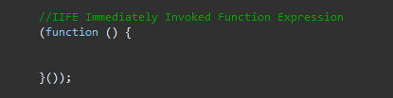
Avoiding JavaScript Goo
Understand the global/public nature of JS
Prevent stepping on our own toes
Avoid polluting the global namespace
Window object
Issues in global namespace
Name collisions and unexpected behavior
IIFE - "Immediately-Invoked Function Expression“
Used widely in Angular to define modules

Slide 16

What is TypeScript
High level language like JavaScript yet offering familiar OO concepts and techniques
Superset of JavaScript
All valid JavaScript is valid TypeScript
Transpiled to JavaScript
Microsoft chose to build atop JavaScript
Big wins for TypeScript in Angular 2.0 adoption
Offers compile-time checking for type safety
Provides features ahead of ECMAScript Standards
Pick your favorite IDE
Intellisense!

Slide 17

TypeScript Advantages
Low barrier of entry
Keep those JS skills!
…and flexibility of a dynamic language if needed
Can adopt completely on the server
tsc.exe
Break down the barriers of having ‘MyApp.js’
Scripting language vs. OO style language
Open source from day 1
Maintained by Microsoft, Apache License
#failfast

Slide 18

TypeScript to JavaScript Language Comparison
Compile time type safety checking
More concise syntax
Syntactical Sugar makes getting from A -> B easier
Familiar keywords
Scope is easier to follow

Slide 19
TypeScript Language
Core Fundamentals
Type Safety
Modules
Classes
Interfaces
Generics
Features
Async/await
Decorators
JSX Support
tsconfig.json support
Class Expressions

Slide 20
Type Definition Files
Leverage Intellisense and strong type checking
The leading repository of TypeScript definitions: DefinitelyTyped
http://definitelytyped.org/
https://github.com/borisyankov/DefinitelyTyped
Get type definition files from NuGet
Files exist for most mainstream JS libraries
Popular type definition files:
AngularJS
jQuery
Generate .d.ts files based on TypeScript models via command line

Slide 21

Using TypeLite with .NET Classes
Generate TypeScript Interfaces (definition files - t.ds) from .NET classes
Get Intellisense when working with your managed classes
Great way to work with know server types in your TypeScript code
Uses a .tt T4 template file to configure
Download and add to project from NuGet

Slide 22
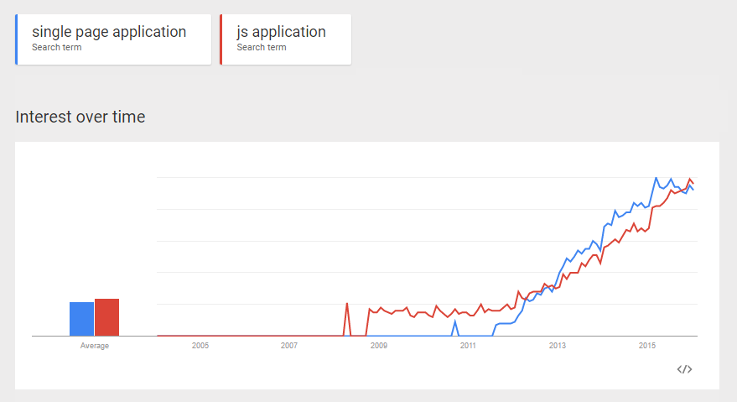
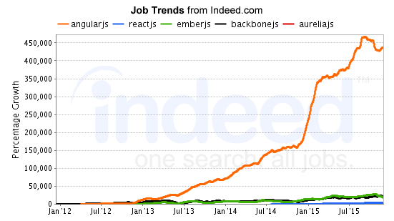
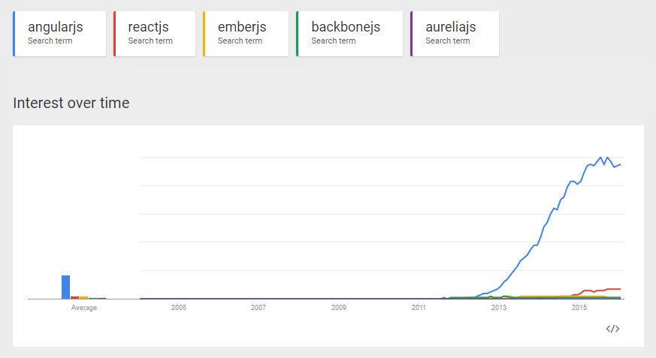
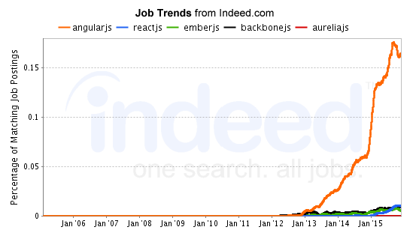
JavaScript Framework Popularity

Slide 23

AngularJS
Complete client side MVW framework for creating JavaScript Applications
Compliments the server
Originally started at Google, now OSS
Declarative style of programming
Manipulating the DOM
Imperative style of programming
Expressing logic
Easy to use and learn

Slide 24
Architecting an AngularJS 1.x App
Core Concepts
Data binding
Directives
Templates/Views
Controllers
Models
Services
Custom and Provided
Dependency Injection

Slide 25

Moving Beyond the Basics
Controller As Syntax
Thin out controllers
Architecting for reuse
Performance
TypeScript

Slide 26

Angular 2.0 Primer
Component-Based UI
Angular 1.x Controllers & Directives morph into Components
Better performance
$scope is gone
ng-upgrade = Angular 1.x + 2.0
Migrate more easily

Slide 27

Responsive Design
Further elevate your code :: eyeball ratio
Foot in the door for mobile devices
Invest in your base template
Core technique: CSS Media Queries (CSS3)
Tools for testing
Use a framework like Bootstrap to get responsive design out of the box from day 1

Slide 28
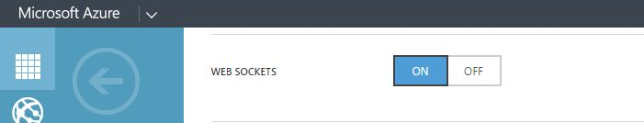
SignalR
Real-time push communication
Notifications, streaming, etc.
Azure Web Sites supports Web Sockets
Leverages existing application’s authentication mechanism
[DEMO]

Slide 29

JS App Performance & Debugging
The big payoff – fast, fast, fast and don’t forget… efficient!
Save CPU usage on the server
Save network bandwidth
Use ‘Network’ tab in debugging tools
Request count
Size
Time
Techniques
Caching
Bundling / Minification
Application Insights

Slide 30
Useful References
MyVote URL
http://myvote.azurewebsites.net
MyVote on GitHub
https://github.com/Magenic/MyVote
Plunker
http://plnkr.co/
Bootstrap
http://getbootstrap.com/
UI Bootstrap (Angular directives)
http://angular-ui
Azure Mobile Services
http://azure.microsoft.com/en-us/documentation/services/mobile-services/
Angular 1.x
https://angularjs.org/
Angular 2.0
https://angular.io/
github.io/bootstrap/
AngularJS API Docs
https://docs.angularjs.org/api
AngularJS Training
http://egghead.io/
http://thinkster.io/
http://www.pluralsight.com/
Angular 1 and Angular 2 information
http://angularjs.blogspot.com/

Slide 31

Questions
Thank you for attending Modern Apps LIVE!

